Slide 1

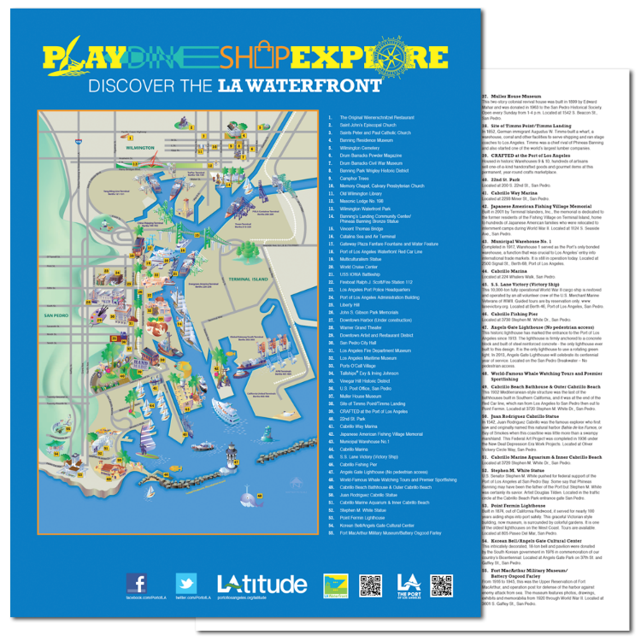
Port of
Los Angeles
LA Waterfront Map
Promotional/Advocacy Materials

